Slide 1
COVID-19 Radiography
Nathan Choi, Simone Ong, Kelly Short, Elizabeth Willard
December 12th, 2023
Notes:
[Elizabeth] Hello everyone, hope everyone is doing well in whatever time zone you are in! My colleagues Nathan, Simone, Kelly, and myself are going to present today about a machine learning model on COVID-19 Radiography images.

Slide 2
Agenda
Motivation
EDA (review images)
Modeling (Multi-Class): Loss, Activation Parameters
Experiments
Conclusions/Results
Notes:
[Elizabeth] For our agenda today, we are going to be going over our motivation for our research, some basic EDA steps and charts, our suggested model including chosen parameters, and conclude with results of our baseline as well as improved model.

Slide 3
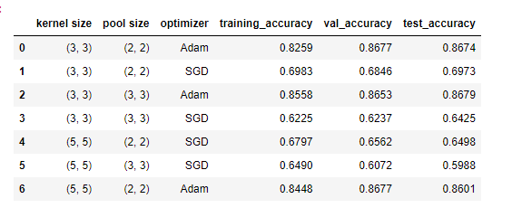
Motivation
Covid impacted us on a global scale and continues on to this day!
Given team members background we found a personal interest in the Malaysia Datasets
Predicting Covid lungs we found to be relevant and timely
As a team we agreed we wanted a project which was more image based, here are our overall plan steps to achieve our goal:
Process Images Before Training
Build Multi-Class Model
Train Model
Vary parameters
End Goal: Train a multi-class classification model to label illnesses on x-ray images
Results:
Notes:
[Elizabeth] With the impact of COVID-19 that is still affecting everyone to this day, we wanted to take a look at it on a global scale. We also wanted to incorporate a project that was more computer-vision oriented and utilized images inside its dataset. With this in mind, we did some searching on Kaggle and sourced a COVID-19 imaging dataset from Malaysia that met this criteria. Our overall approach involves cleaning and condensing our image dataset, building a model that will be able to intake an x-ray image and classify it with it’s appropriate illness label, train that model with the data from our found dataset, and then review our results to find the best accuracy and loss metrics in order to determine best parameters for our classification model. Our results yielded a 85.58% training accuracy, 86.53% validation accuracy and 86.79 test accuracy.

Slide 4
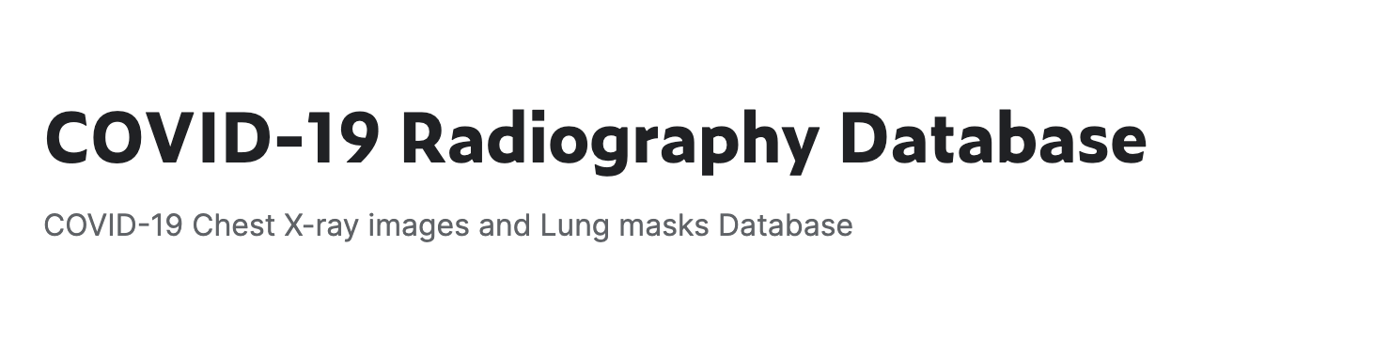
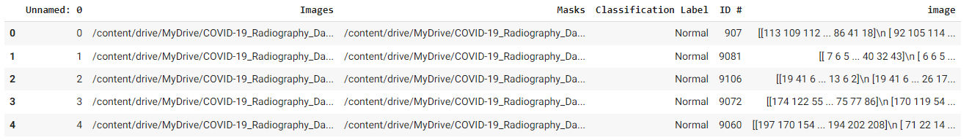
Data
Main Source of Data: https://www.kaggle.com/datasets/tawsifurrahman/covid19-radiography-database
Images and Masks are shown as image paths, but we did a small transformation that would return it as an array in order for it to be opened by imread
Graphs of label distribution
Notes:
[Elizabeth] Our main source of data, our Kaggle dataset was a combination of multiple sources condensed into one dataset. Utilizing glob, we created an array of paths that could be used by imread to process the images and masks. You can see that in the “image” column imread has turned the image into an array to be further processed when we access it later. I wll not pass it to Kelly who will be talking more about our EDA process.

Slide 5
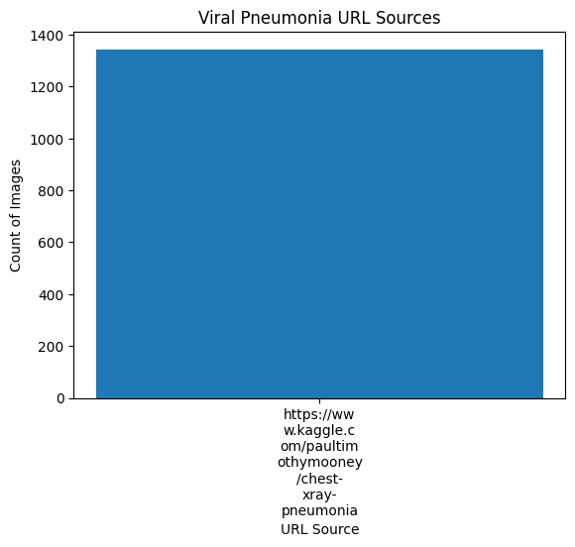
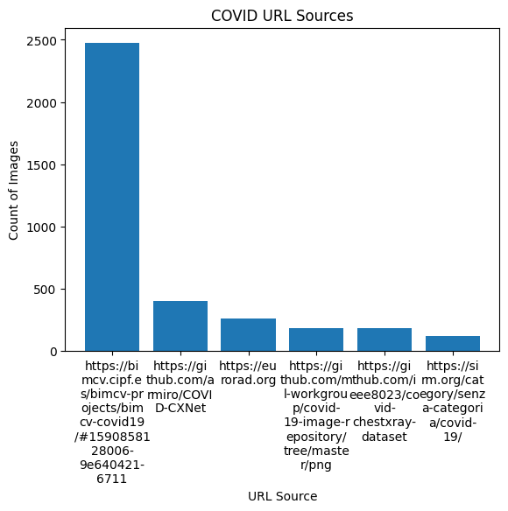
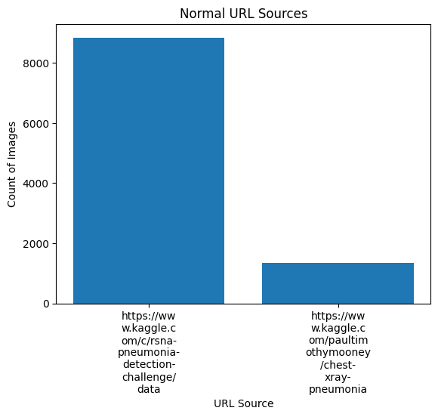
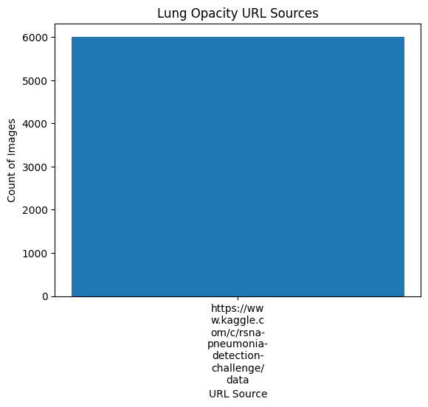
Sources Bar Chart
Notes:
[Kelly] According to the Kaggle description of our dataset: A team of researchers from Doha, Qatar, and Bangladesh along with their collaborators from Pakistan and Malaysia in collaboration with medical doctors have created the data set. We additionally wanted to look at the information on the sourced images and where they come from to glean further insights, you can see the various URL links in the charts on this slide. Most of the other sources for Normal, Lung Opacity, and Viral Pneumonia come from this kaggle data set which was compiled. The largest COVID source is actually the Medical Imaging Databank of the Valencia Region but also comes from the European Society of Radiology and the Italian Society of Radiology.

Slide 6
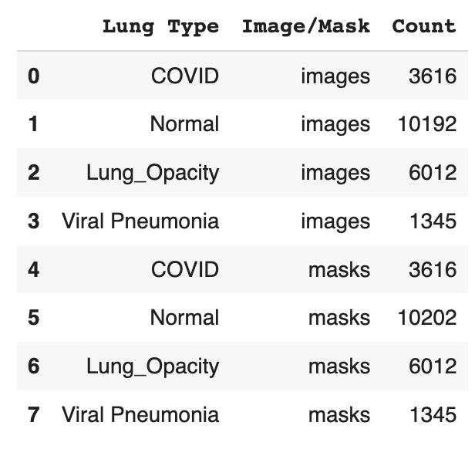
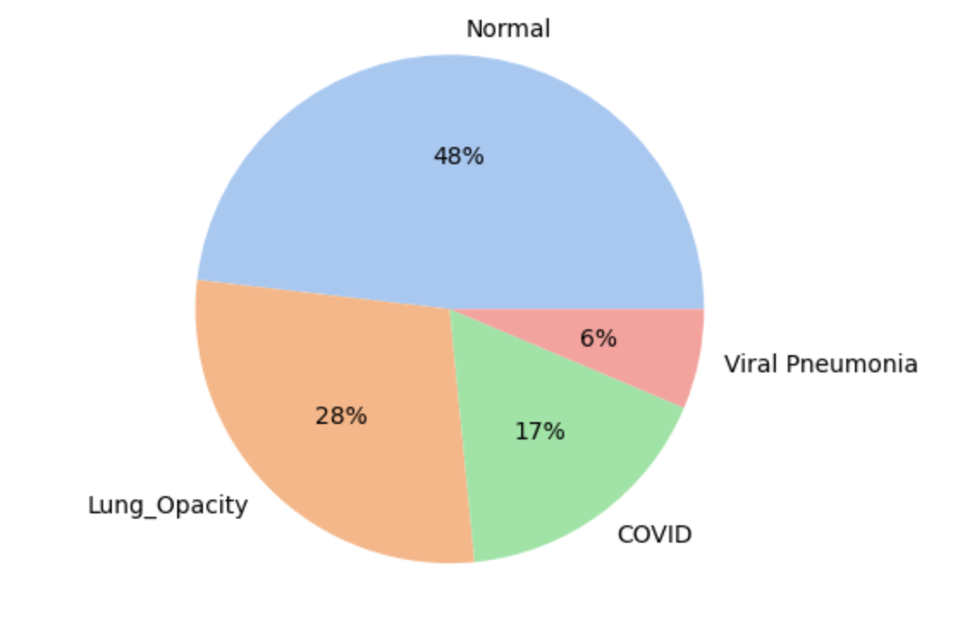
Data cont.
Recap of our label distribution
Notes:
[Kelly] Just a recap of what our classification type distribution looked like, we had around half of our x-ray photos as normal lung photos, around a quarter as lung_opacity, and then 17% covid and the last 6% viral pneumonia.

Slide 7
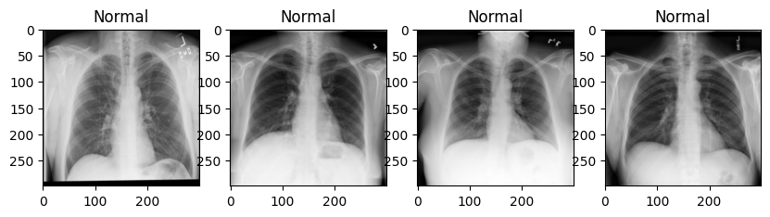
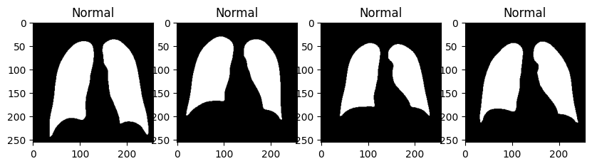
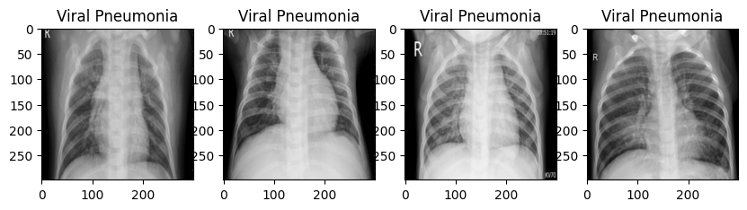
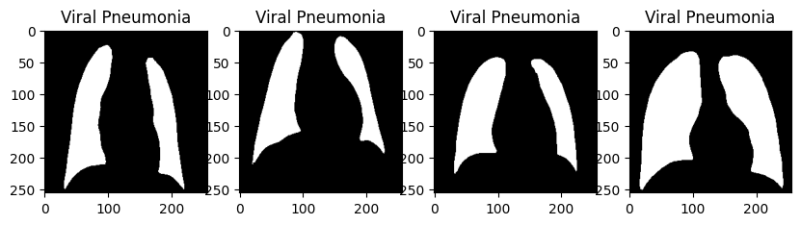
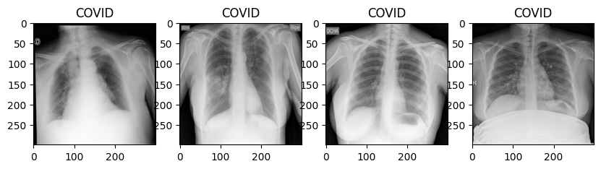
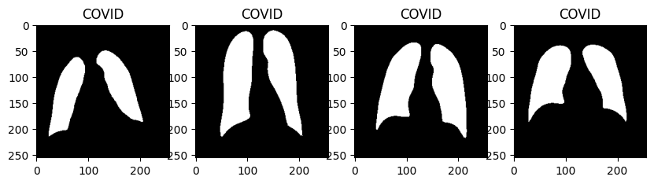
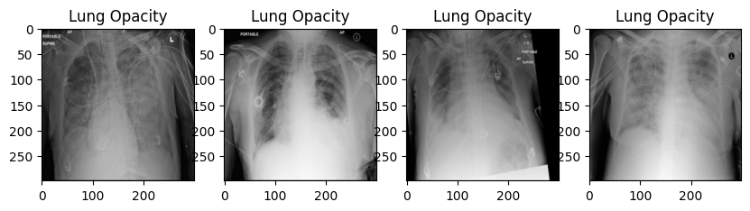
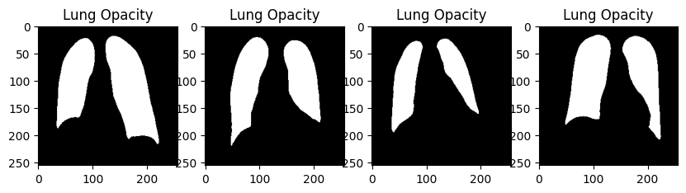
Data cont.
Recap of what our images looked like ( Original Images and Masked Images ) :
Notes:
[Kelly] Another visual of the data that we are working with, we had both the images and masks for each picture. While our original plan was to utilize the mask in order to tell the model where to look on the x-ray image, we figured that it should still look holistically at the entire image and that because the x-rays didn’t have background noise or anything to differentiate that without or without masks would yield similar results.

Slide 8
Data Pre-processing
Visually looked into the different lung types ( Covid, Pneumonia, Lung Opacity, Normal)
We investigate the URL links of the various images provided
We looked into both the masked data provided as well as the core xray images
We split the Train/Test/Validation datasets into different data frames ( 70/20/10)
Notes:
[Kelly] We manually inspected images of the different lung types present within the dataset and compared these to the provided mask images from the database. We also inspected the original sources of the images within the dataset. Finally, we split this dataset into three dataframes comprising of Train/Test/Validation.
For our train, test, and validation sets, we are creating arrays of these images, not their paths. So it will look like what is here at the bottom, where the images are inside the array in a randomly selected and random order. I will now pass it to Simone who will talk about our model creation.

Slide 9
Model Build
Pre-Processing:
We initially explored leveraging albumentation but decided to keep our pipeline simple - our kernel in collab continued to crash
The main preprocessing that we did was to resize images to be smaller
Model Approach
We selected a CNN
We built Layers - 11 in Total
Because of the four different labels we have selected multi-class over binary
Notes:
[Simone] When beginning to implement the model, we initially explored leveraging the package albumentations to create various transformations of the training dataset. Although we did test albumentation in order to expose the model to more variations, but kept running into kernel crashes since the albumentations transformations pipeline is picky about which transformations come after what. So, in order to simplify this step, we resized the images to be smaller and finally began to select a model. What we noticed in some sample cases was that because most of example images that needed a lot of processing were unique (such as a picture of a cat in a field), as opposed to x-ray images which is already in black and white and already focused on one area, we didn’t necessarily need to utilize albumentation because our images already were very uniform. We did just make them smaller in order for the model to not take as long to run.
We decided on a CNN and constructed 11 layers in total. Because there are multiple labels for these images, we selected a multi-class as opposed to binary selection.

Slide 10
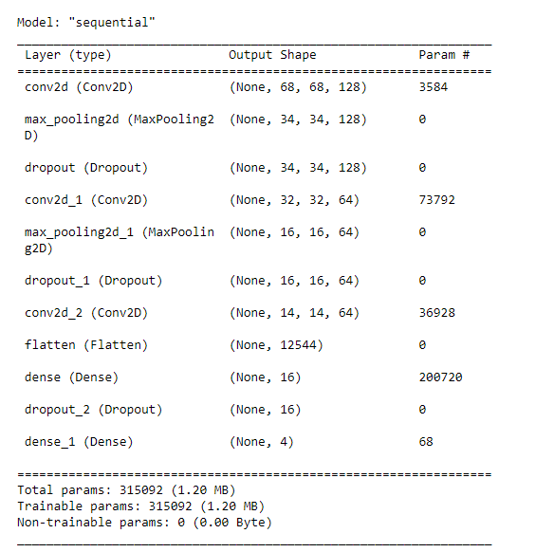
Baseline Models
CNN Approach was applied
Sparse Categorical Loss because of our different categories ( 4 categories )
Relu activation for our layers
We decided to initially run both Adam and SGD model optimizers as a baseline
Adam performed with an accuracy of 86.74% on test dataset
SGD performed with an accuracy of 69.73% on test dataset
Below are the model.summary() parameters that were used:
Notes:
[Simone] To provide a little more context on how we were able to build up to our multi-class model, we first started off building a binary classifier. We split our labels into 0 and 1 for Not-Covid and COVID. We then built our model with 11 layers and once we were able to verify that this worked, we changed into into a multi-class. We wanted to also see if this would fare better results versus classifying them into our four labels.
For our baseline models, we decided to run two models, the only change is that one was with the Adam optimizer and the other is with SGD optimizer. We utilized sparse categorical cross entropy as our loss function because of our four different categories of image types. After running both the Adam and SGD model optimizers, we saw that the Adam optimizer outperformed SGD on the test dataset, so we deemed this our baseline.

Slide 11
Modeling Experimentation
We then created a dataframe to iterate through other hyperparameters
The output of our results looked as follows:
Best
Notes:
[Simone] In order to test different variations compared to our baseline model, we decided on changing up kernel size, pool size, and the optimizer. We wanted to increase kernel size because we had more parameters because our classification labels creates four groups instead of just two. We also wanted to changed the pooling size that way it would be more or less resistant to noise because increasing the pool size could help with the object detection and in this case there is some slight differences in normal lung images vs lung images with illnesses. After running our data through all these models, we found that our best model was when we used a kernel size of (3,3), pool size of (3,3) and the Adam optimizer. I will now pass it to Nathan who will be discussing the results of our models and our final chosen model.

Slide 12
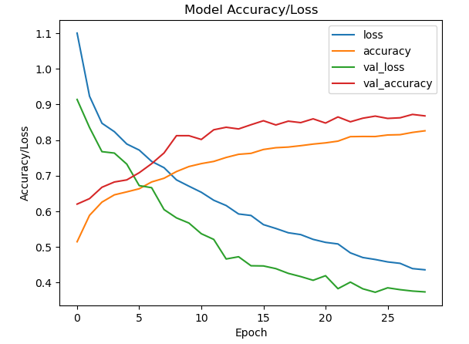
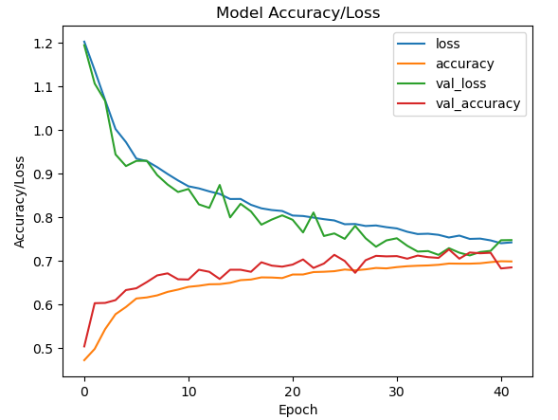
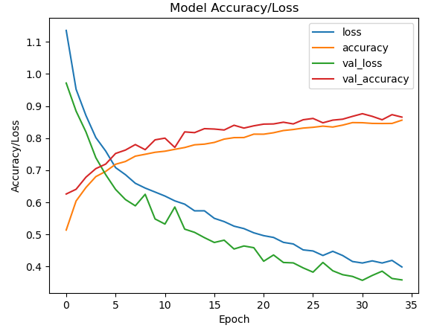
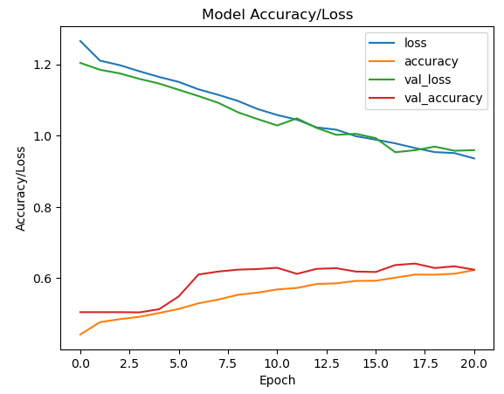
Modeling Experimentation Results
Notes:
[Nathan] Looking at the first four models after changing one variable at a time, we can see that our accuracy varies a lot. For reference, our baseline model is model 0, which starts with parameters of kernel size (3,3), pool size (2,2) and Adam optimizer. Our first model we changed our optimizer to SGD, which we also considered as another baseline model as explain in the slide 2 previous. This accuracy was significantly lower, so even though we kept testing SGD optimizer when changing other parameters, we knew that this might not yield the best results. Model 2 and 3 we changed the pool sizes between the two optimizers. Model 3 in the bottom right corner, you can see there are no gradual curves, which is not what we are looking for in this metric.

Slide 13
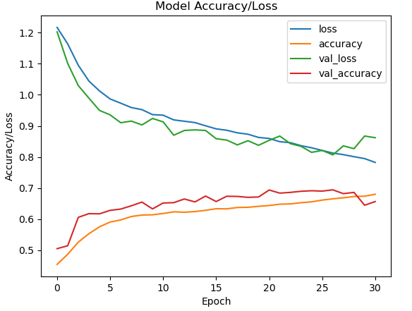
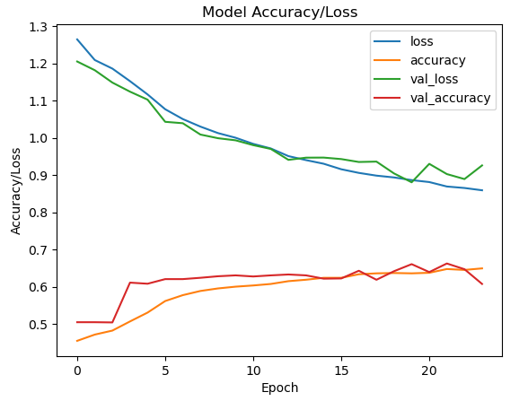
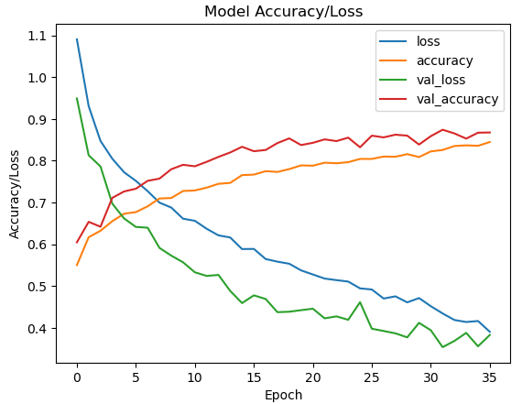
Modeling Experimentation Results cont.
Notes:
[Nathan] We can see the results of our next three models. Again looking at the top two, the accuracies are showing a bit of a plateau which is not ideal because it could mean that our model is starting to overfit.

Slide 14
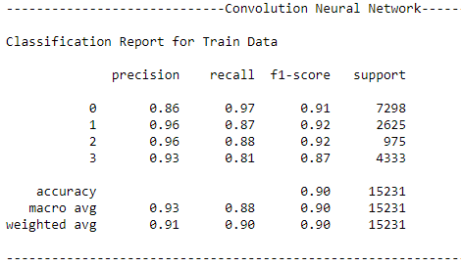
Best Performing Model Training Plot
Normal
Covid
Pneumonia
Lung Opacity
Notes:
[Nathan] Looking at our best model, we can looking at our training loss and accuracy compared to our validation loss and accuracy. Seeing our loss gradually decrease over time and our accuracy increase over time is the shape we are looking for. It means that our model is still learning and hasn't hit the point where it is overfitting on the data. Especially since our losses aren’t near flattening out yet, this gives us a better idea that our model is still in good condition to still learn from the training data.

Slide 15
Conclusions
Our key results of occur classification model are our accuracy and losses from our validation and test data. As noted on the previous page, we are reaching around 86% accuracy for all our data and our graphs are showing increasing shapes which means our model is able to classify well.
One more step further than our classifier is now being able to receive a new set of images that our model hasn’t seen and utilize the classification to label these images; it will serve as a predictive model.
Further analysis could be conducted to optimize metrics like recall

Slide 16
Appendix
Github Repo: https://github.com/elizabethwillard/w207-final-project/tree/main
Notes:
[Nathan] Here is the link to our github repo with our EDA code in one file and our model and experiments in another file.

Slide 17
Appendix
Group Contributions:
Nathan: Model building, slides
Simone: Model building, slides
Kelly: Model experimentation, slides
Elizabeth: EDA, slides
Notes:
[Nathan] We also have a small list of contributions from each team member along each step of the process.

Slide 18
Questions?
Notes:
[Nathan] Thank you and are there any questions?

